Slide 1


CONFIDENTIAL
Continuous Risk and Control Assurance:
Framework and system implementation
Telekom Malaysia Berhad (TM)
Ahmad Fairuz Ali
5 November 2015
1
Notes:
<number>

Slide 2
Purpose
The objective of this presentation is to propose a
Framework on planning continuous risk and control assurance (CRCA) for GIA and
Implementation of a new BIG DATA infrastructure in GIA.
The concept of CRCA are referring to the article by Norman Marks in 2013 entitled “A Look into the Future: The Next Evolution of Internal Audit Continuous Risk and Control Assurance”.
1

Slide 3
Why BIG DATA in Internal Audit ?
BIG DATA for internal audit is referring to in depth data analysis on the company’s transactional event and profile in order to provide detail hindsight perspective and insight of potential future risk.
Example of transactional event are Call Data Record (CDR), ICP or NOVA billing event, NPCS payment details, detail orders, sales commission, RADIUS session, GR, PO and many more.
Example of profile are ICP BRM customer profile, network subscriber profile HSS, staff details in SAP and many more.
Analysis will help to ensure budgeting and risk analysis also become much more accurate tools.
With the huge amount of data being collected and processed, GIA are able to move away from sampling audit to 100% data review in during the audit field.
1

Slide 4
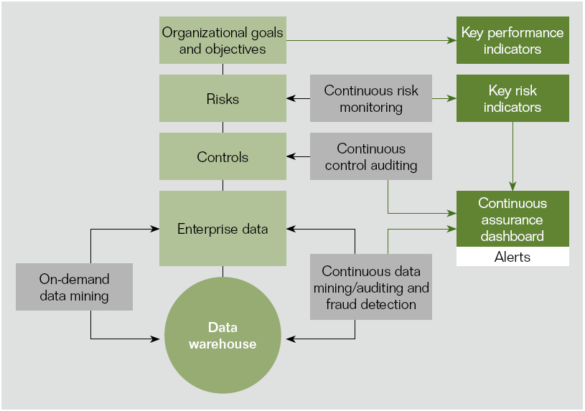
Continuous Risk and Control Assurance framework Model (CRCA)
The benefit of CRCA is automation certain control tests where there was a need to test within specific period of time and to gain insight into related controls in more sensitive business process such as accounts payable and payroll, particularly where there was a high risk.
1

Slide 5
What kind of check can we do?
Integrity check
Pre process check
Post process check
Reconciliation
Completeness.
Controls that relate to protecting the integrity of information, in particular that no information is missing.
Correctness.
Controls that relate to protecting the accuracy of information.
Trend analysis
Identifies issues were current performance deviates from previous, historical performance.
Rating.
Controls that relate to the profitability of a product and/or service.
1

Slide 6
System Implementation based on CRCA framework
Data visualization tools to extract and present the results.(e.g. Excel)
GIA BIG DATA WAREHOUSE
GIA Data ware house consist of data from provisioning (ICP and NOVA Siebel), billing (NOVA and Siebel BRM), network inventory (NIS and Granite), billable CDR and product details rating.
Not all data available in GIT Data ware house (e.g. sales incentives, installer commission, contractors details (Prosys)), hence, recommended that GIA to develop it’s own data mining environment that consist all cumulated data from different sources in TM.
1

Slide 7
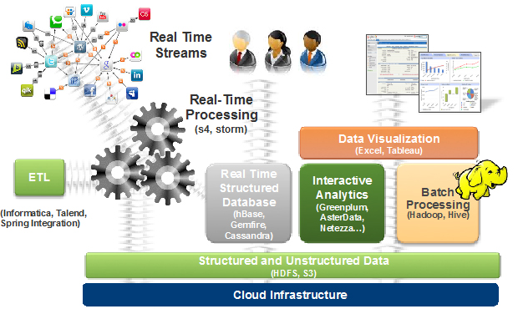
Typical BIG DATA Warehouse implementation
1

Slide 8
Proposed system architecture of GIA BIG DATA Warehouse
Data
Source
(NPCS, MAS,
ND System, NOVA,ICP, SAP, CIPS)
Interactive
Analytics
Application
Server
GIA BIG
DATA
WAREHOUSE
(EDWH)
ETL Application
Server
Dashboard
Application
Server
1

Slide 9
Key Points
Proposed to develop 1.5 years detail program in implementing the CRCA framework in different phases.
Phase 1: Built new GIA BIG DATA warehouse mining environment.
Join effort with GIT BIG DATA warehouse (GEMS) which include ETL application only. GIT are using Oracle Integrator ETL.
Purchase 2 application servers for interactive analytics and dashboards.
Or develop in-house.
Phase 2: Developing controls and prioritizing Key Risk Indicators (KRI) for coverage 1 (Network, IT and Consumer) .
Phase 3: Developing controls and prioritizing KRI for coverage 2 (Finance, Managed Account, HR).
Phase 4: Developing continuous assurance dashboard.
1

Slide 10
Challenges
Apart of data sources in GIT, there are plenty of others data sources in network, marketing and subsidiaries.
Continuous effort are required to improve the quality of data feed into the GIA BIG DATA warehouse. Solution : emphasize on data governance.
Agile approach requires continuous effort in improving the varieties of analytics. Solution : specific timeframe must be allocated for development and good documentation.
Huge amount of storage will be required when more data sources are being feed. Solution : Review on the capacity planning every 6 months.
Processing and analyzing data will require specific skills and learning. Solution : Training provided for the intended staff.
1

Slide 11
THANK YOU
<number>

